Slide 1
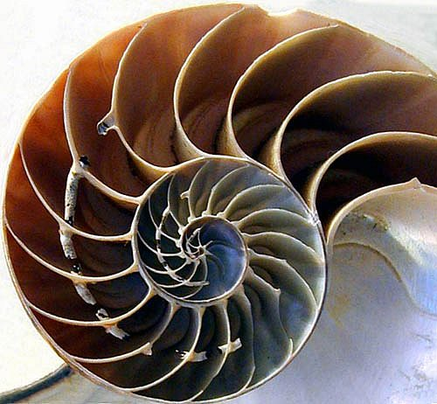

Pattern Recognition
Instructor
Hui XUE (薛晖)
Southeast University
Notes:
人的模式识别能力，小菜一碟；
“自动点名系统”
有用，有意思，有挑战性

Slide 2

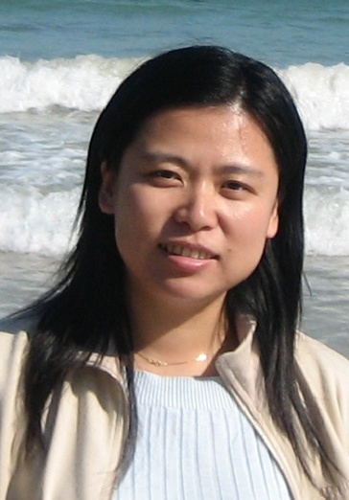

The First Pattern
Email:
hxue@seu.edu.cn
URL:
http://palm.seu.edu.cn/hxue/

Slide 3
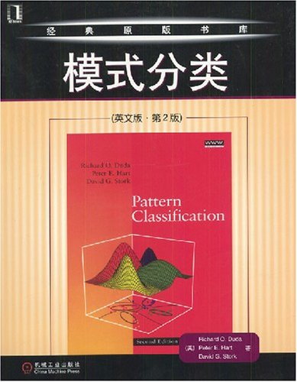
The Second Pattern
Richard O. Duda, Peter E. Hart, David G. Stork
Pattern Classification, 2nd edition
John Wiley & Sons, 2001
模式分类 (英文版·第2版)
机械工业出版社, 2004

Slide 4
The Third Pattern
Credits
3 credits with 48 teaching hours and 16 experimental hours
Week 2 – Week 16, Monday & Wednesday
About scores
Attendance: 5%
Quiz: 10%
Project: 25%
Final Exam: 60%

Slide 5
References
Books
S. Theodoridis, K. Koutroumbas. Pattern Recognition, 4th edition. Elsevier Publishers, 2009.
C. Bishop. Pattern Recognition and Machine Learning. Cambridge University Press, 2007.
张学工. 模式识别(第三版). 清华大学出版社, 2010.
Web Resources
International Association for Pattern Recognition (IAPR)
Pattern Recognition Journal (PRJ)
List of pattern recognition web sites

Slide 6
Remarks
Mathematical background
Linear algebra
Probability theory
Statistics
Information theory
......

Slide 7
Remarks (Cont.)
No pain, No gain
Classroom lectures are important but not enough
Review what have been taught with at least 4~6 hours per week
Terminologies and Contents
Representing in English, Teaching in Chinese
Examinations in English

Slide 8
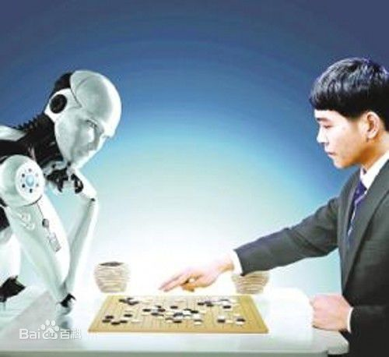


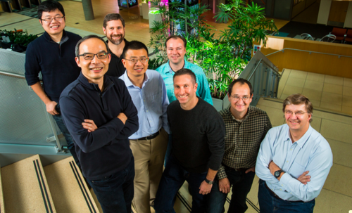
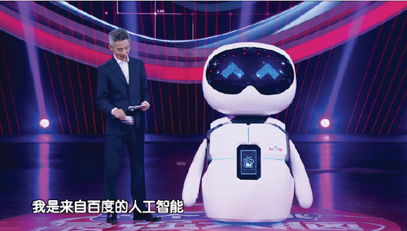
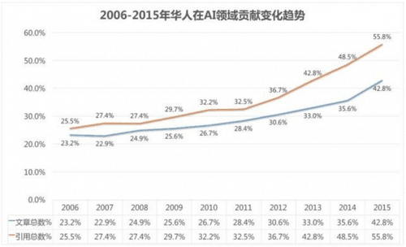
Artificial Intelligence

Slide 9

Artificial Intelligence
国务院印发了《新一代人工智能发展规划》，提出了六方面的重点任务和一系列保障措施，要求到2020年人工智能总体技术和应用与世界先进水平同步，人工智能核心产业规模超过1500亿元，带动相关产业规模超过1万亿元；到2030年，我国人工智能理论、技术与应用总体达到世界领先水平。

Slide 10


Artificial Intelligence and COVID-19
AI + CT Screening

Slide 11
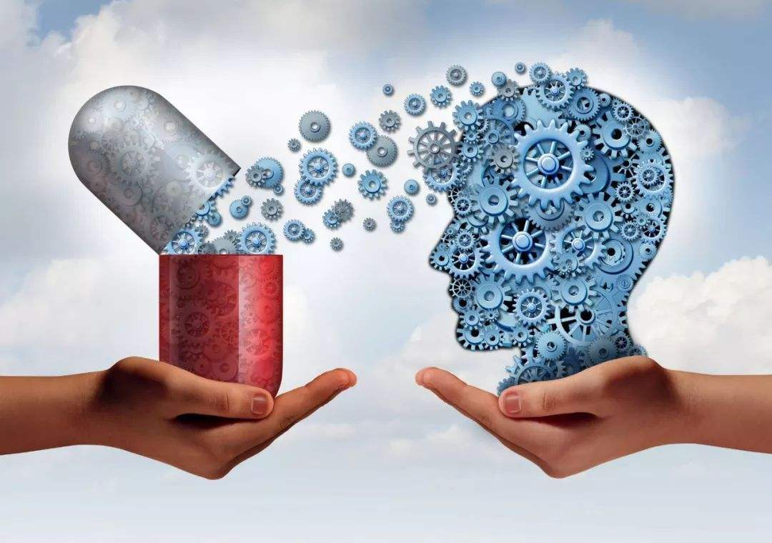
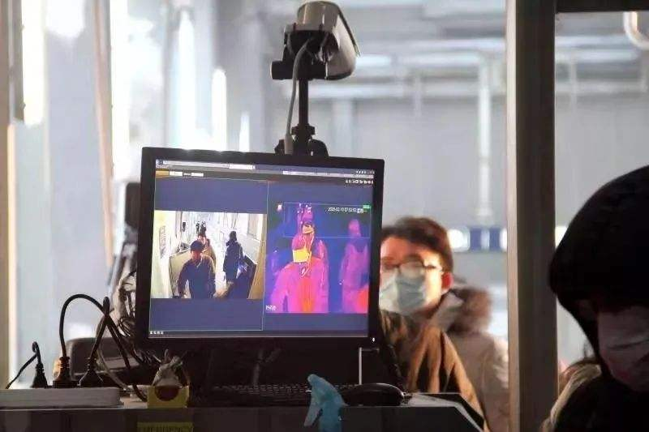
Artificial Intelligence and COVID-19
AI + Targeted Drug Research
AI + Check Body Temperature

Slide 12

Artificial Intelligence and COVID-19
AI + Information Gathering

Slide 13
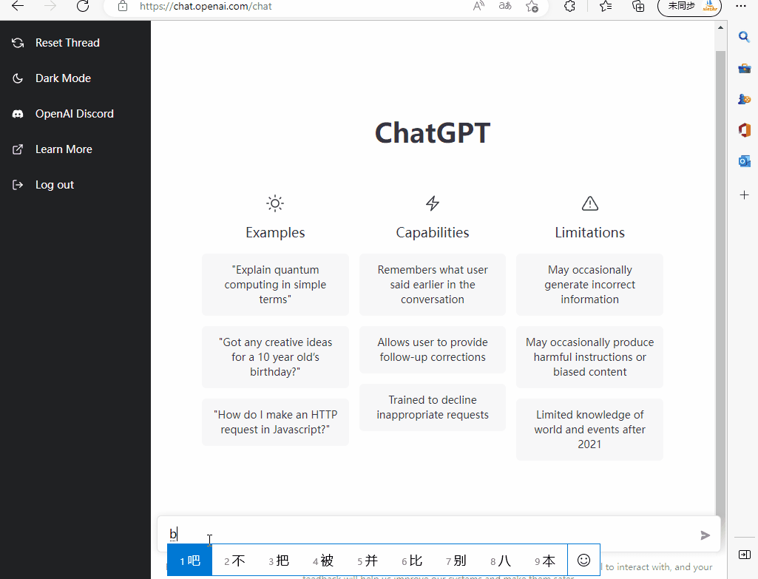
ChatGPT
ChatGPT（全名：Chat Generative Pre-trained Transformer），美国OpenAI研发的聊天机器人程序，于2022年11月30日发布。ChatGPT是人工智能技术驱动的自然语言处理工具，它能够通过学习和理解人类的语言来进行对话，还能根据聊天的上下文进行互动，真正像人类一样来聊天交流，甚至能完成撰写邮件、视频脚本、文案、翻译、代码，写论文等任务。

Slide 14
Remark
What's the use of Pattern Recognition？
One of the core issues in AI：computer vision，natural language processing，speech recognition，…
One of the most hot research fields in computer science
Common interests of Microsoft、Google、Baidu、...
So ...
Find the most cool job
Research
...

Slide 15
Ch 01. Introduction

Slide 16
"To understand is to perceive patterns"
– Isaiah Berlin
Notes:
英国哲学家
20世纪最著名之一

Slide 17
The 3W of Pattern Recognition
What is Pattern Recognition (PR)?
What is Pattern?
What is Recognition?
What is Pattern Recognition?
Why do we need Pattern Recognition?
The necessity and importance for pattern recognition
HoW to perform Pattern Recognition?
The building blocks of a pattern recognition system

Slide 18
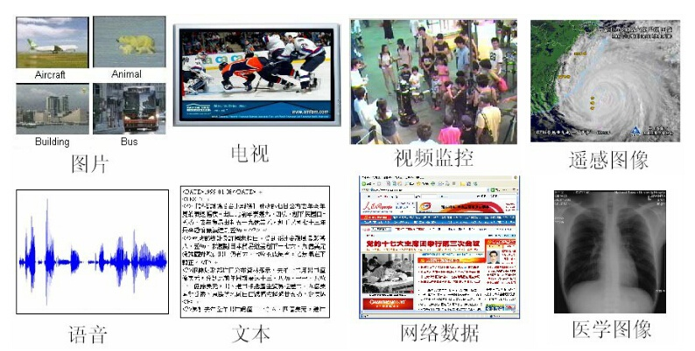
What's Pattern?
“A pattern is the opposite of a chaos; it is an entity vaguely defined, that could be given a name.” – Satoshi Watanabe
Notes:
渡边慧，日本著名理论物理学家
狡猾大大地

Slide 19
What's Pattern?
There are various kinds of patterns
Visual patterns (视觉模式) such as eyes, nose, mouth, face, fingerprint, etc.
Temporal patterns (时序模式) such as speech, audios, videos, data streams, etc.
Logical patterns (逻辑模式) such as characters, strings, images, etc.
……

Slide 20
What's Recognition?
“Identification of a pattern as a member of a category we already know, or we are familiar with” – Anil K. Jain
Classification (Known Classes)
Clustering (Unknown Classes)
Categories are known and the task is to assign a proper class label for each pattern
Classification (分类)
Categories are unknown and the task is to learn categories and group the patterns accordingly
Clustering (聚类)

Slide 21
What's Recognition?
Classification: An example
We already know the categories of characters, and then classify the handwritten ones into category “A” and category “B”
Clustering: An example
We do not know the categories of symbols, and then learn the categories and group the symbols accordingly

Slide 22
What's Pattern Recognition?
Pattern recognition is the procedure of processing and analyzing diverse information (numerical, literal, logical) characterizing the objects or phenomenon, so as to provide descriptions, identifications, classifications and interpretations for them.
对表征事物或现象的各种形式的（数值的，文字的和逻辑关系的）信息进行处理和分析，以对事物或现象进行描述、辨认、分类和解释的过程，是信息科学和人工智能的重要组成部分。

Slide 23
What's Pattern Recognition?
“The real power of human thinking is based on recognizing patterns. The better computers get at pattern recognition, the more humanlike they will become”. – Ray Kurzweil, NY Times, Nov 24, 2003

Slide 24
What's Pattern Recognition?
A “Perceive + Process + Prediction” View
It is the study of how machines can
Perceive: Observe the environment (i.e. interact with the real-world)
Process: Learn to distinguish patterns of interest from their background
Prediction: make sound and reasonable decisions about the categories of the patterns

Slide 25
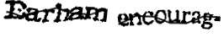
Applications of Pattern Recognition
1) Character Recognition [字符识别]
Input: images with characters (normally contaminated with noise)
Output: the identified character strings (Earham encourag)
Useful in scenarios such as automatic license plate recognition (ALPR), optical character recognition (OCR), etc.

Slide 26
Applications of PR (Cont.)
2) Speech Recognition [语音识别]
Input: acoustic signal (e.g. sound waves)
Output: contents of the speech
Useful in scenarios such as speech-to-text (STT), voice command & control, etc.

Slide 27
Applications of PR (Cont.)
3) Fingerprint Recognition [指纹识别]
Input: fingerprints of some person
Output: the person’s identity
Useful in scenarios such as computerized access control, criminal pursuit, etc.
Notes:
指纹相同的概率：六十亿分之一

Slide 28
Applications of PR (Cont.)
4) Signature Identification [签名验证]
Input: signature of some person (sequence of dots)
Output: the signatory’s identity
Useful in scenarios such as digital signature verification, credit card anti-fraud, etc.

Slide 29

Applications of PR (Cont.)
5) Face Detection [人脸检测]
Useful in scenarios such as digital camera capturing, video surveillance, etc.
Input: images with several people
Output: locations of the peoples’ faces in the image

Slide 30

Applications of PR (Cont.)
6) Text Categorization [文档分类]
Input: document, web pages, etc.
Output: category of the text, such as political, economic, military, sports, etc.
Useful in scenarios such as information retrieval, document organization, etc.

Slide 31
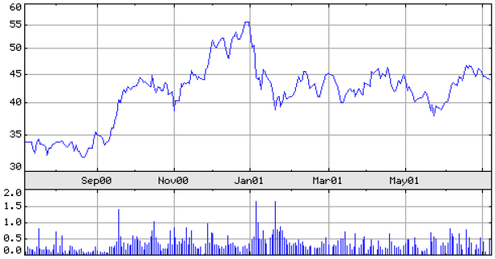
Applications of PR (Cont.)
7) Financial Forecast [财务预测]
Input: stock price time series
Output: Bull market?
Bear market?

Slide 32
Applications of PR - More
Problem | Input | Output
Non-destructive testing | Ultrasound, eddy current, acoustic emission waveforms | Presence/absence of flaw, type of flaw
Detection and diagnosis of disease | ECG, EEG waveforms | Types of cardiac conditions, classes of brain conditions
Natural resource identification | Multispectral images | Terrain forms, vegetation cover
Aerial reconnaissance | Visual, infrared, radar images | Tanks, airfields
Character recognition (page readers, zip code, license plate) | Optical scanned image | Alphanumeric characters
Identification and counting of cells | Slides of blood samples, micro-sections of tissues | Type of cells
Inspection (PC boards, IC masks, textiles) | Scanned image (visible, infrared) | Acceptable/unacceptable
Manufacturing | 3-D images (structured light, laser, stereo) | Identify objects, pose, assembly
Web search | Key words specified by a user | Text relevant to the user

Slide 33
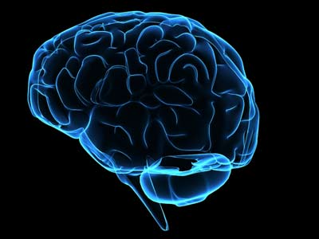
Best pattern recognition system
Human Brain！

Slide 34
Why need pattern recognition?
For humans, pattern recognition is natural & easy
recognize a face
understand spoken words
read handwritten characters
identify items by feel
decide whether an apple is ripe by its smell
……
For computers, pattern recognition is never easy
All in all, pattern recognition is important, useful, attractive, but rather challenging
Challenges ➔ Opportunities

Slide 35
Basic Concepts
Model (模型)
Descriptions which are typically mathematical in form [以数学形式表达的性质]
e.g. image ➔ matrix; sound waves➔ frequency vector
Sample (样本)
Representatives of the patterns we want to classify [分类的基本对象，模式的实例]
e.g. fingerprint of a suspect; ECG of a patient
Training Set (训练集)
A set of samples used to train classifiers [用于训练分类器的样本集合]
Notes:
训练集 vs. 测试集
习题 vs. 考试

Slide 36
Basic Concepts (Cont.)
Test Set (测试集)
A set of samples to be classified, usually being mutually exclusive to training set [用于测试分类器的样本集合,通常与训练集无交集]
“Training set” vs. “Test set” ⬄ “Homeworks” vs. “Exams”
Feature (特征)
Attributes which characterize properties of the samples [用于刻画样本性质的属性]
e.g. to characterize a person, we may use features such as height, weight, age, salary, occupation, etc.

Slide 37
Basic Concepts (Cont.)
Feature Vector (特征向量)
Vector formed by a group of features, usually in column form [由一组特征组成的向量，通常表示为列向量]
vector component (in italic)
transpose operator
feature vector (in boldface)
dimensionality (number of features)

Slide 38
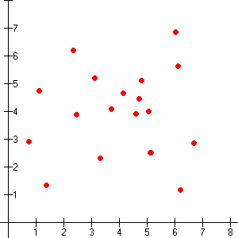
Basic Concepts (Cont.)
Feature Space (特征空间)
Space containing all the possible feature vectors [由所有可能的特征向量组成的数据空间]
e.g. the d-dimensional Euclidean space R^{d}
Scatter Plot (散布图)
Each sample is plotted as a point in the feature space [将每个样本表示为特征空间中的一个点]
a 2D scatter plot

Slide 39
Basic Concepts (Cont.)
Decision Boundary (决策边界)
Boundaries in feature space which separate different categories [特征空间中区分各个类别的边界]
linear boundary
quadratic boundary
complex boundary

Slide 40
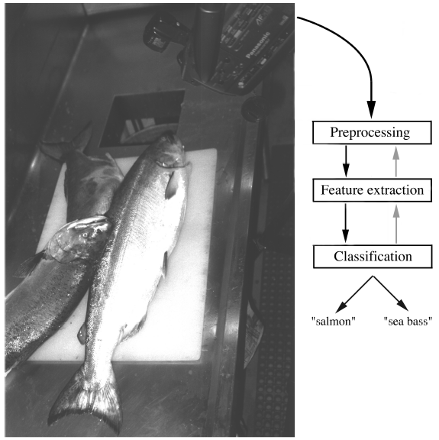
How to do pattern recognition?
An Example
The task: Automate the process of sorting incoming fish on a conveyor belt according to species
Separate sea bass from salmon [鲈鱼 vs. 鲑鱼]
Three basic steps

Slide 41
Example: “Sea bass” vs. “Salmon”
Step I: Preprocessing (预处理)
Goal: Preprocess the image captured by the camera, such that subsequent operations could be simplified without losing relevant information
Adjust the level of illumination
Denoising
Enhance the level of contrast
Routine image processing
Isolate different fishes from one another
Isolate fishes from the background
segmentation
......

Slide 42
Example: “Sea bass” vs. “Salmon”
Step II: Feature Extraction (特征抽取)
Goal: Extract features (with good distinguishing ability) from the preprocessed image to be used for subsequent classification
Sea bass is usually longer than a salmon
“length” could be a good candidate for features
Sea bass is usually brighter than a salmon
“lightness” of fish scales could be another good candidate for features
......

Slide 43
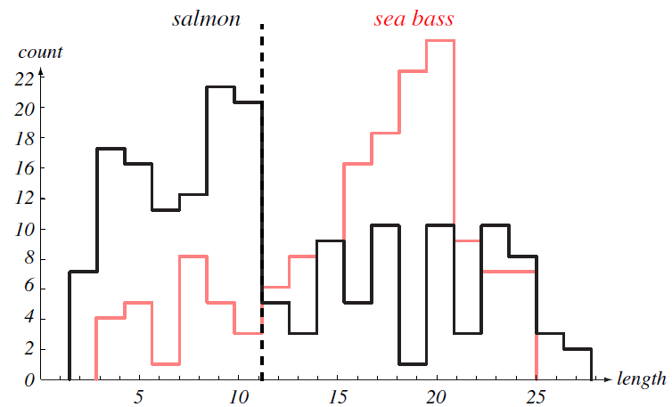
Example: “Sea bass” vs. “Salmon”
Step III: Classification (分类)
Goal: To distinguish different types of objects (in this case, sea bass vs. salmon) based on the extracted features
h-axis: length of fish
v-axis: number of fishes with a certain length
On average, sea bass is somewhat longer than salmon
Too much overlaps ➔ poor separation with the length feature
histogram for length

Slide 44
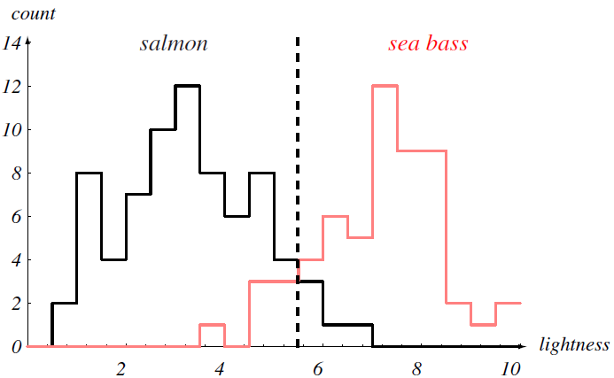
Example: “Sea bass” vs. “Salmon”
h-axis: lightness of fish scales
v-axis: number of fishes with a certain lightness
On average, sea bass is much brighter than salmon
Less overlaps ➔ better separation with the lightness feature, but still a bit unsatisfactory
histogram for lightness
What if no other single feature yields better performance?
Use more features at the same time!

Slide 45
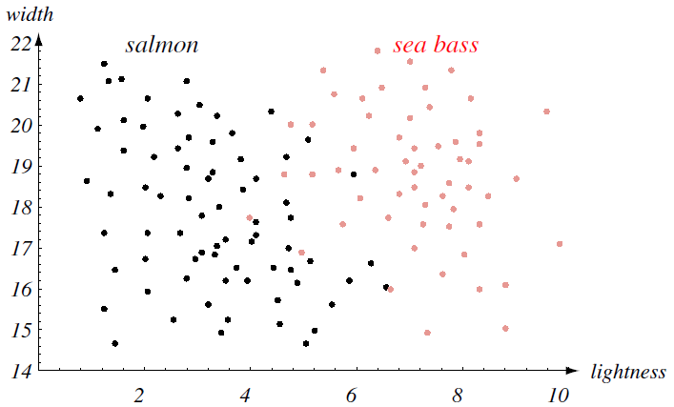
Example: “Sea bass” vs. “Salmon”
Using two features simultaneously
black dots: salmon samples
red dots: sea bass samples
Linear decision boundary:
Much better than single feature
scatter plot for the feature vectors

Slide 46
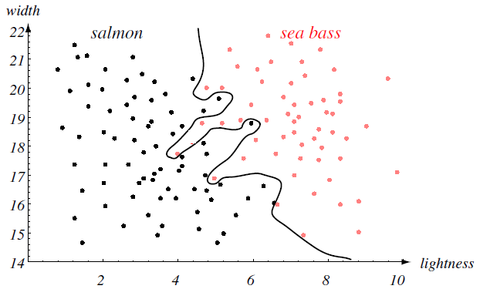
Example: “Sea bass” vs. “Salmon”
Linear decision boundary:
Complex decision boundary
All the training samples (i.e. known patterns) have been separated perfectly
Can we truly feel satisfied?

Slide 47
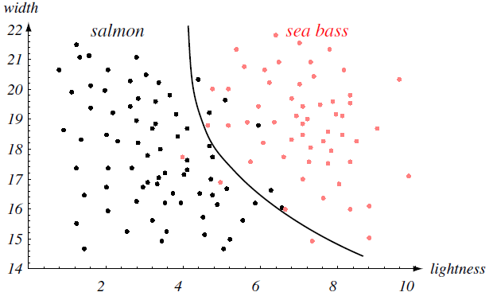
Example: “Sea bass” vs. “Salmon”
Generalization
[泛化能力/推广能力]
The ultimate goal!
The central aim of designing a classifier is to make correct decisions when presented with novel (unseen/test) patterns, not on training patterns whose labels are already known
e.g. it’s useless to get 100% accuracy when answering homework questions while get low accuracy when answering exam questions
Performance on the training set
Tradeoff
Simplicity of the classifier

Slide 48
Related Fields to PR
Pattern Recognition: Pattern ➔ Category
Hypothesis Testing (假设检验)
Null hypothesis ➔ Rejection or Not
E.g.: To determine whether a drug is effective; Null hypothesis: it has not effect
Image Processing (图像处理)
Image ➔ Image
Regression (回归分析)
Pattern ➔ Real Value
Interpolation (插值)
Pattern (unexplored input range) ➔ Interpolated Value
Density Estimation (概率密度估计)
Patterns ➔ Probability density function (pdf) for different categories
Often employed as preliminary steps in pattern recognition
Notes:
H_0:原假设
H_1:备择假设

Slide 49
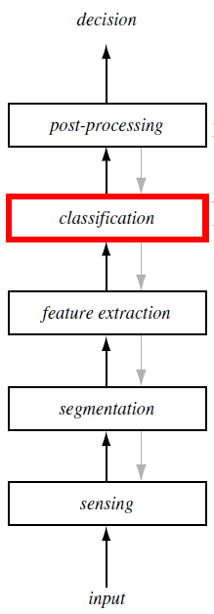
Pattern Recognition System
A post processor decide on the appropriate action based on the classification
In addition to the usual “bottom-up” flow of data, some systems also employ feedback from higher levels back down to lower levels (gray arrows)
A classifier uses extracted features to assign the sensed object to a category
A feature extractor measures object properties that are useful for classification
A segmentor isolates sensed objects from the background or from other object
A sensor converts physical inputs (e.g. images, sounds) into digital signal data
Notes:
后处理将分类结果转化为具体决策和行动

Slide 50
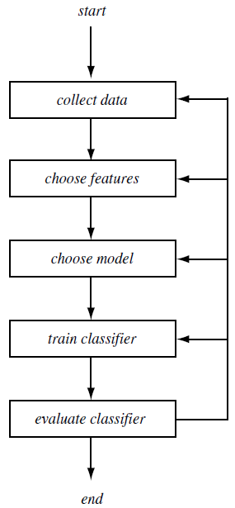
Design Cycle of PR System
The design of a PR system usually entails a number of different activities, such as data collection, feature choice, model choice, classifier training, classifier evaluation.
Data collection accounts for a large part of the cost of developing a PR system
Feature choice and model choice are highly domain-dependent, where prior knowledge (先验知识) plays very important role
e.g.: lightness might be a good feature for distinguishing sea bass and salmon; linear model might be preferred than nonlinear ones
Various activities may be repeated in order to obtain satisfactory results
Notes:
特征：x_1,x_2
模型：ax_1+bx_2+c>0
训练：根据训练集，确定a,b,c

Slide 51
Important Issues in Pattern Recognition
Noise (噪声)
Model Selection (模型选择)
Segmentation (分割)
Overfitting (过配)
Data Collection (数据采集)
Context (上下文)
Domain Knowledge (领域知识)
Classifier Ensemble (分类器集成)
Feature Extraction (特征抽取)
Costs and Risks (代价与风险)
Pattern Representation (模式表示)
Computational Complexity (计算复杂度)
Missing Features (缺失特征)
……

Slide 52
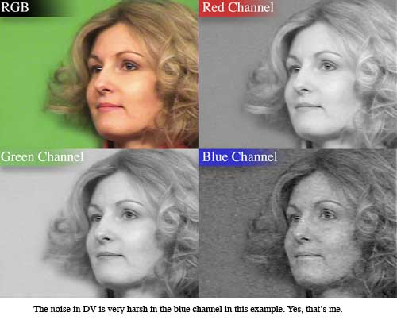
噪声（noise）
Various types of noise (e.g., shadows, conveyor belt might shake, etc.)
Noise can reduce the reliability of the feature values measured.
Knowledge of the noise process can help improve performance.

Slide 53
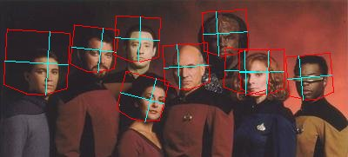
分割（Segmentation）
Individual patterns have to be segmented.
How can we segment without having categorized them first ?
How can we categorize them without having segmented them first ?
How do we "group" together the proper number of elements ?
Notes:
Startreck

Slide 54
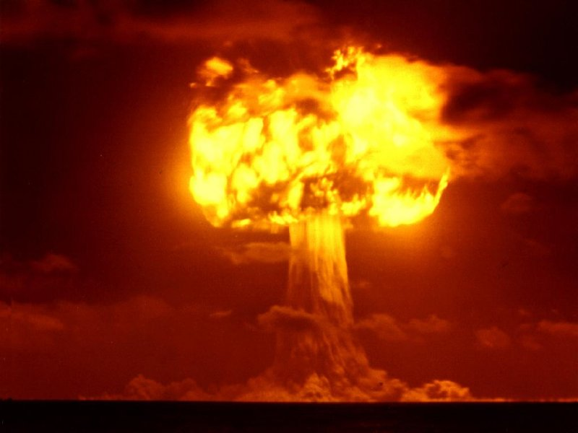
数据采集（Data Collection）
How do we know that we have collected an adequately large and representative set of examples for training/testing the system?
The cost of data collection could be prohibitively high

Slide 55
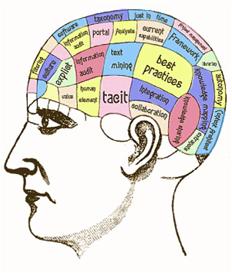
领域知识（Domain Knowledge）
When there is not sufficient training data, incorporate domain knowledge:
Model how each pattern is generated - this is difficult !! (e.g., recognize all types of chairs).
Incorporate some knowledge about the pattern generation method. (e.g., optical character recognition (OCR) assuming characters are sequences of strokes)

Slide 56
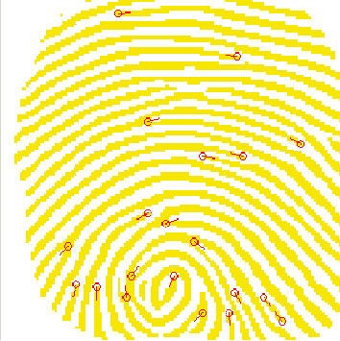
特征抽取（Feature Extraction）
It is a domain-specific problem which influences classifier's performance.
Which features are most promising ?
Are there ways to automatically learn which features are best ?
How many should we use ?
Choose features that are robust to noise.
Favor features that lead to simpler decision regions.

Slide 57
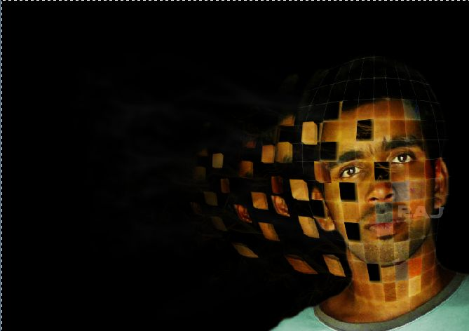
模式表示（Pattern Representation）
Similar patterns should have similar representations.
Patterns from different classes should have dissimilar representations.
Pattern representations should be invariant to transformations such as:
translations, rotations, resize, reflections, non-rigid deformations
Small intra-class variation, large inter-class variation.

Slide 58
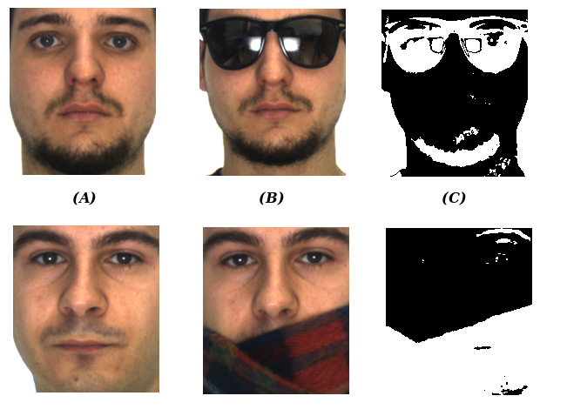
缺失特征（Missing Features）
Certain features might be missing (e.g., due to occlusion).
How should the classifier make the best decision with missing features?
How should we train the classifier with missing features ?

Slide 59

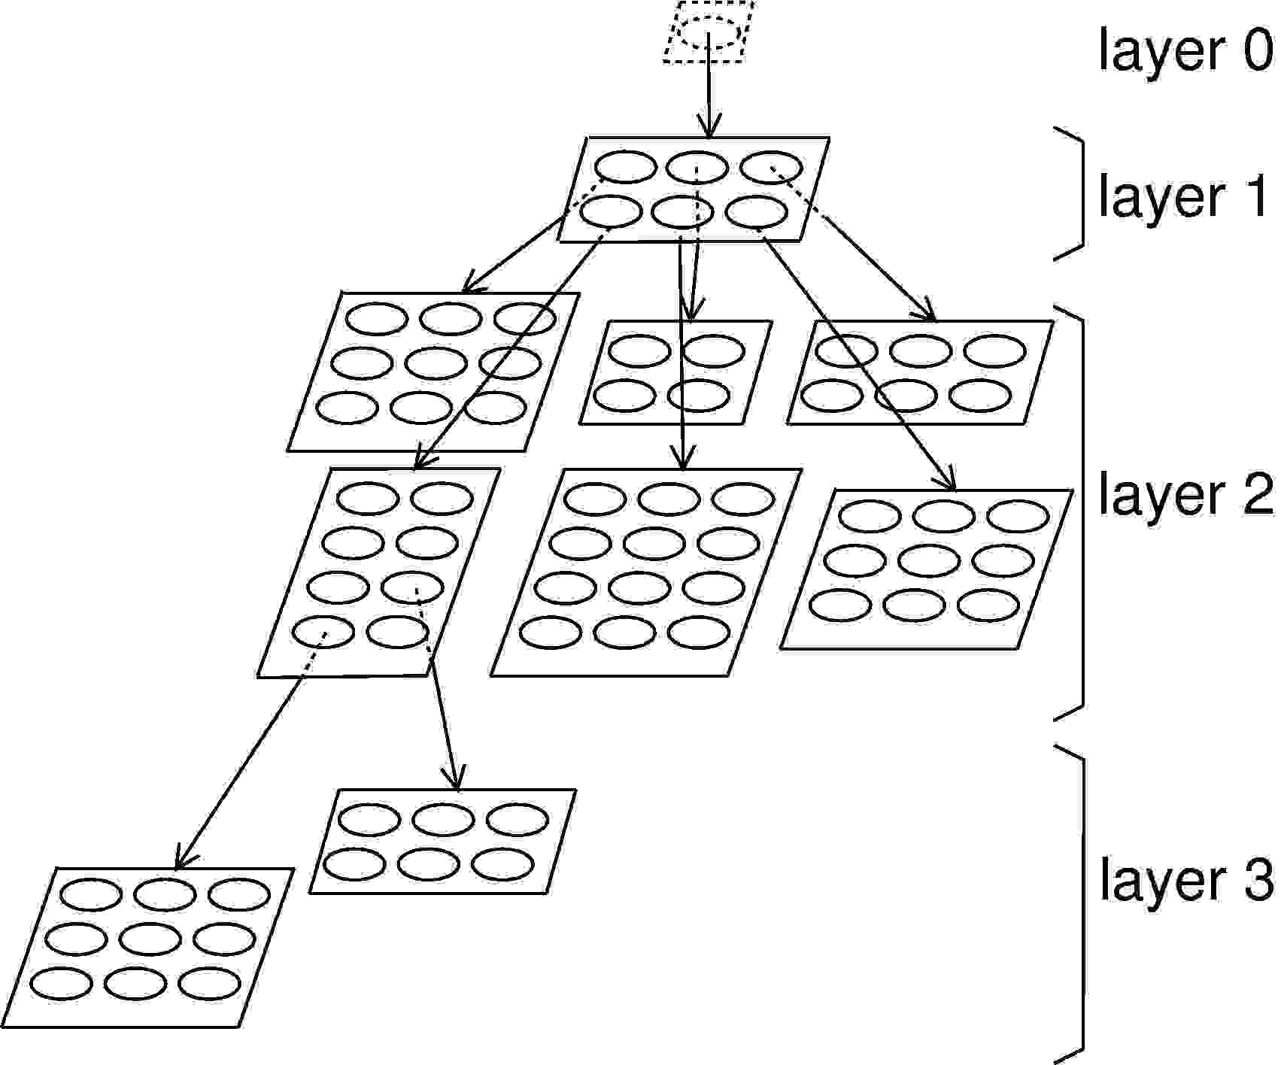
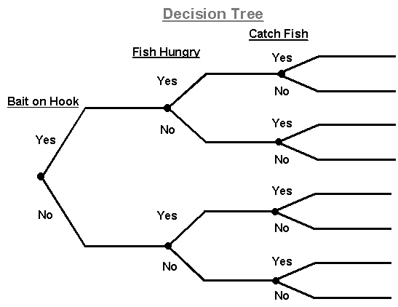
模型选择（Model Selection）
How do we know when to reject a class of models and try another one ?
Is the model selection process just a trial and error process ?
Can we automate this process ?

Slide 60
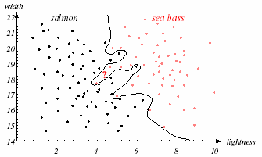
过配（Overfitting）
Models complexer than necessary lead to overfitting (i.e., good performance on the training data but poor performance on novel data).
How can we adjust the complexity of the model? (not very complex or simple).
Are there principled methods for finding the best complexity?

Slide 61
上下文（Context）
The same pattern within different context might have different meanings
Context is very helpful!
How m ch info mation are y u mi sing

Slide 62
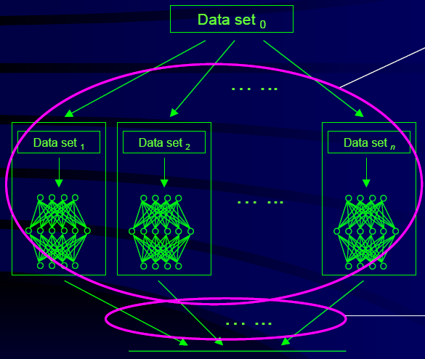
分类器集成（Classifier Ensemble）
Performance can be improved using multiple classifiers.
How should we combine multiple classifiers?

Slide 63

代价与风险（Costs and Risks）
Each classification is associated with a cost or risk (e.g., classification error).
How can we incorporate knowledge about such risks?
Can we estimate the lowest possible risk of any classifier?

Slide 64
计算复杂度 （Computational Complexity）
How does an algorithm scale with
the number of feature dimensions
number of patterns
number of categories
Brute-force approaches might lead to perfect classifications results but usually have impractical time and memory requirements.
What is the tradeoff between computational ease and performance?

Slide 65
计算复杂度 （Computational Complexity）
“Universal” image recognizer
Mark all possible combinations of pixel values in a 100*100 gray image
For a new image, just use the "look-up table" method to find the same image in all tagged image libraries, and get its class
Unacceptable computational complexity
Computational complexity must be considered in practical applications

Slide 66
Summary
What is Pattern Recognition?
Pattern
The opposite of chaos
Various kinds: visual patterns, temporal patterns, logical patterns,
etc.
Recognition
Identification of a pattern as a member of a category
Classification: categories known ➔ assign proper class label for
each pattern
Clustering: categories unknown ➔ learn categories and group patterns
Pattern Recognition
Perceive: observe the environment (i.e. interact with the real-world)
Process: learn to distinguish patterns of interest
Prediction: make sound and reasonable decisions about the categories
Notes:
广泛的应用
人脑证明可行
很多待解决的问题

Slide 67
Summary (Cont.)
Why Pattern Recognition?
Pattern recognition is needed in designing almost all automated and intelligent systems
Applications of pattern recognition are ubiquitous
Character recognition (images ➔ characters)
Speech recognition (speech ➔ text)
Fingerprint recognition (fingerprints ➔ person’s identity)
Signature identification (signature ➔ signatory’s identity)
Face detection (images ➔ face locations)
Text categorization (documents ➔ semantic categories)
……

Slide 68
Summary (Cont.)
How Pattern Recognition?
Basic concepts
model, sample, training set, test set, feature, feature vector, feature space, scatter plot, decision boundary
An illustrative example: “sea bass” vs. “salmon”
Generalization: Make correct decisions given novel patterns
Components of Pattern Recognition System
sensing ➔ segmentation ➔ feature extraction ➔ classification ➔ post-processing ➔ ……

Slide 69
Summary (Cont.)
How Pattern Recognition?
Design Cycle of Pattern Recognition System
collect data ➔ choose features ➔ choose model ➔ train classifier ➔ evaluate classifier ➔ ……
Important Issues
Noise
Model Selection
Segmentation
Overfitting
Data Collection
Context
Domain Knowledge
Classifier Ensemble
Feature Extraction
Costs and Risks
Pattern Representation
Computational Complexity
Missing Features
……

Slide 70
Generalized Target
Humans have the ability to switch rapidly and seamlessly between different pattern recognition tasks
It is very difficult to design a device that is capable of performing a variety of classification tasks
Different decision tasks may require different features.
Different features might yield different solutions.
Different tradeoffs (e.g., classification error) exist for different tasks.

Slide 71
Generalized Target
The fundamental purpose of pattern recognition is to reconstruct the inner model of pattern generation
Each pattern recognition technique relies on a hypothetical model
Each pattern recognition problem implies an intrinsic model
“Best method”？
Effectiveness of a pattern recognition technique in a given problem depends on the degree of agreement between the hypothetical model of the technique and the internal model of the problem
No pattern recognition technology for all problems
There is no broad sense of "best method", but it is possible to find a solution to a problem "best method"

Slide 72
Basic methods
Based on Known knowledge
For certain patterns, human knowledge can be well classified and recognized. In this case, a good classifier can be designed directly based on known knowledge.
Rare
Based on“Learning from samples”
Given a set of samples for a number of target patterns
Learning a classifier from these samples using a learning algorithm
Most cases, it is also the main topic of pattern recognition

Slide 73
Basic methods
Learning Models (学习范式)
Supervised Learning（有监督学习）
Unsupervised Learning（无监督学习）
Semi-supervised Learning（半监督学习）
Reinforcement Learning（强化学习）
Incremental Learning（增量学习）
…
Notes:
学习是指用某种算法来降低训练样本的分类误差。如梯度下降法等。

